Slide 1
Playing to Win: Exploring the Causal Relationship between Game Features and Positive User Feedback in the Steam Marketplace
Timothy Toth

Slide 2
What Impacts Positive Ratings for Video Games in the Steam Marketplace
The video game industry has experienced tremendous growth in recent years, with the emergence of digital distribution platforms like Steam, which allow developers to distribute and sell their games directly to consumers.
Positive ratings on Steam are critical for a game's success, as they can influence a potential buyer's decision to purchase the game. 86% of players report paying attention to review scores
Therefore, understanding the factors that impact positive ratings on Steam is crucial for developers seeking to improve their games' sales and success.

Slide 3
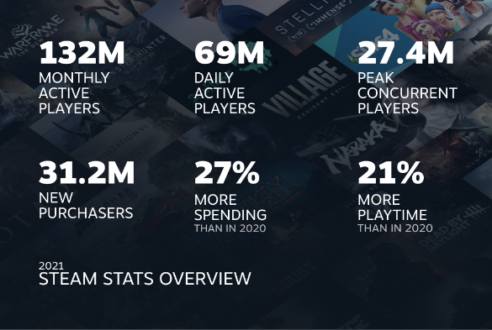
What is Steam?
Steam is the largest digital distribution platform for PC games, with over 120 million monthly active users in 2021 and thousands of games available for purchase
In 2020, the top 100 games on Steam generated $14.3 billion in revenue, highlighting the significant impact that positive ratings can have on a game's success.

Slide 4
Why should we care?
For game developers, understanding the factors that impact positive ratings on Steam can help improve their games' sales and overall success.
For gamers, knowing what factors influence a game's positive ratings on Steam can help them make more informed purchasing decisions.
Additionally, understanding the relationship between these factors and positive ratings can provide valuable insights into consumer behavior in the video game industry.

Slide 5
Previous Literature
In theory, positive ratings and reviews improve a video games success

Slide 8
Data
 | (1)
 | Table 1: Summary Statistics Table
 | mean | sd | min | max
positive_ratings | 3127.586 | 33835.92 | 0 | 2644404
average_playtime | 451.1197 | 3214.551 | 0 | 190625
negative_ratings | 651.906 | 7638.706 | 0 | 487076
price | 7.117333 | 8.25545 | 0 | 78.99
has_achievements | .6233046 | .4845861 | 0 | 1
lower_bound | 255859.2 | 1541797 | 20000 | 1.00e+08
num_platforms | 1.649251 | .8466294 | 1 | 3
genresfreetoplay | .1401109 | .3471225 | 0 | 1
genresearlyaccess | .0556669 | .2292909 | 0 | 1
N | 8479

Slide 9
Empirical Strategy

Slide 10
The models
positive_ratings=β0+β1achievements+β2negative_ratings+β3price+β4i.num_platforms+β5average_playtime
Or can be seen as alternatively
positive_ratings = β0 + β1xi + ηZit + ui
where xi is the variable of interest(achievements), Zi is a vector of covariates (negative_ratings, price, i.num_platforms, average_playtime), and ui is the error term.

Slide 11
OLS and WLS
Standard errors in parentheses
* p < 0.10, ** p < 0.05, *** p < 0.01
 | (1) | (2) | (3) | (4)
 | OLS | OLS w/ RSE | OLS | WLS
achievements | 1.706 | 1.706* | 0.814 | -15.38
 | (1.293) | (0.904) | (0.836) | (11.05)
average_playtime |  |  | 0.354*** | 0.227***
 |  |  | (0.0749) | (0.0639)
negative_ratings |  |  | 3.352*** | 1.759***
 |  |  | (0.0315) | (0.0466)
price |  |  | -45.36 | 43.89***
 |  |  | (28.91) | (12.61)
1.num_platforms |  |  | 0
 |  |  | (.)
2.num_platforms |  |  | 810.3
 |  |  | (668.7)
3.num_platforms |  |  | 3483.7***
 |  |  | (570.4)
num_platforms |  |  |  | 1603.7***
 |  |  |  | (81.71)
_cons | 3055.1*** | 3055.1*** | 89.40 | -1712.1***
 | (371.5) | (386.0) | (372.7) | (177.5)
N | 8479 | 8479 | 8479 | 5285
R² | 0.000 | 0.000 | 0.583 | 0.270
adj. R² | 0.000 | 0.000 | 0.583 | 0.269

Slide 14
Results summarized

Slide 15
Conclusions

Slide 16
Contextual Economic Theory
Our investigation seeks to understand the relationship between various game features and positive_ratings on the Steam marketplace.
This is rooted in the economic theory of consumer choice, where individuals make decisions based on their preferences and budget constraints.
We will be using regression analysis to explore the impact of specific game features on positive_ratings, while controlling for other factors that may influence this relationship.

